Slide 1
Java programming #6 Application testing Continuous Integration Gitlab CI
Dmitry Chub
@dmchub

Slide 2
Warm-up questions
Why do we need testing?
What is our goal when we create tests?

Slide 3
Type of testing
Unit testing
Check each part (unit) of application separately
Integration testing
Check parts of application working together
System or End to End (End2End) testing
Check entire system (application)

Slide 4
JUNIT 5
JUNIT 5 is our main testing framework
(What is difference between framework and library?)
Official documentation
https://junit.org/junit5/docs/current/user-guide/

Slide 5
Add Junit5 dependency
<dependency>
<groupId>org.junit.jupiter</groupId>
<artifactId>junit-jupiter</artifactId>
<version>5.8.2</version>
<scope>test</scope>
</dependency>

Slide 6
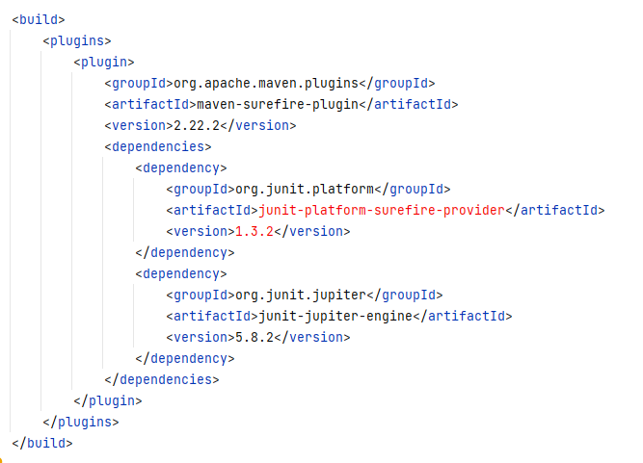
Add plugin for maven to run tests

Slide 7
Annotations
@Test | Denotes that a method is a test method
@BeforeEach | Denotes that the annotated method should be executed before each @Test
@AfterEach | Denotes that the annotated method should be executed after each @Test
@BeforeAll | Denotes that the annotated method should be executed before all @Test
@AfterAll | Denotes that the annotated method should be executed after all @Test
all annotations
https://junit.org/junit5/docs/current/user-guide/#writing-tests-annotations

Slide 8
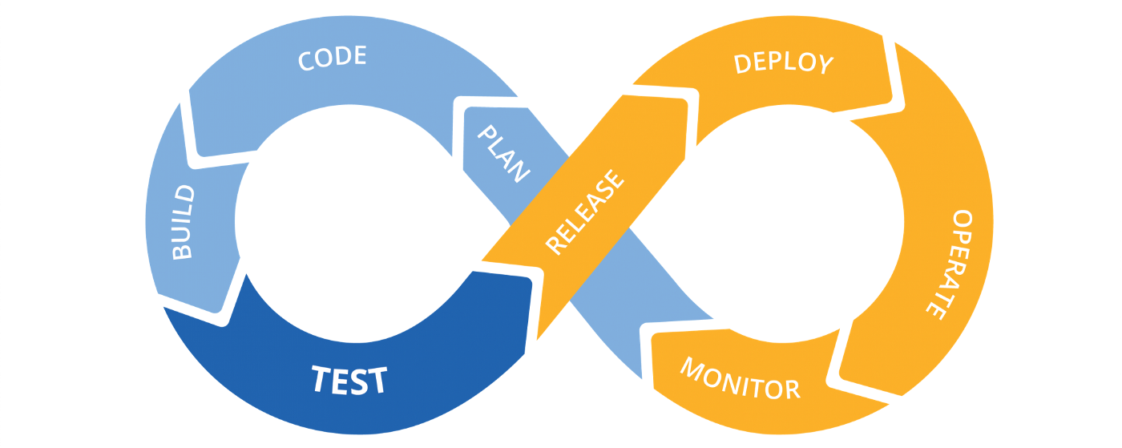
CI / CD

Slide 9
Gitlab CI
official documentation
https://docs.gitlab.com/ee/ci/quick_start/
Here we need to
Configure .gitlab-ci.yml
Configure runner

